Slide 1
eFontys
Security Programming
Radu Alexandru, Raditya Surya Pratama, Georgiana Manolache, Armin Roushan, Jan-Niklas Schneider, Nena O’Driscoll

Slide 2
Security breaches have been increasing considerably over the last decade, becoming an everyday problem for both low and high-profile organizations.

Slide 3
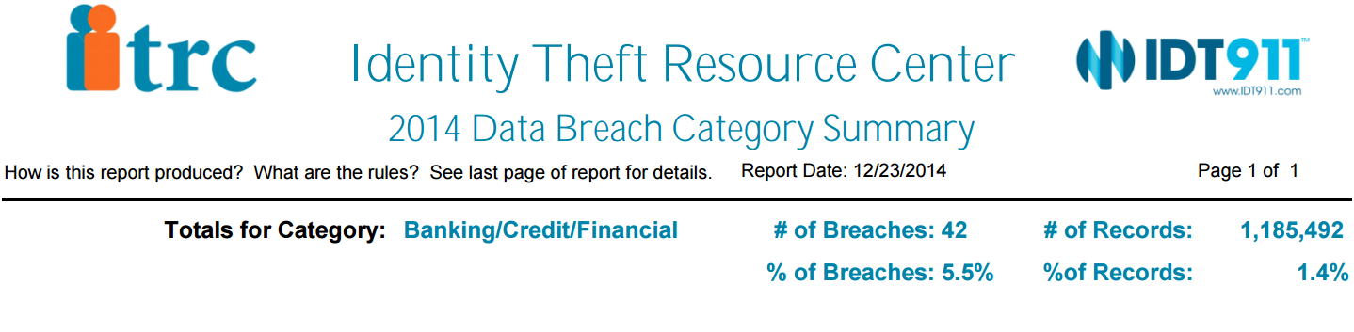
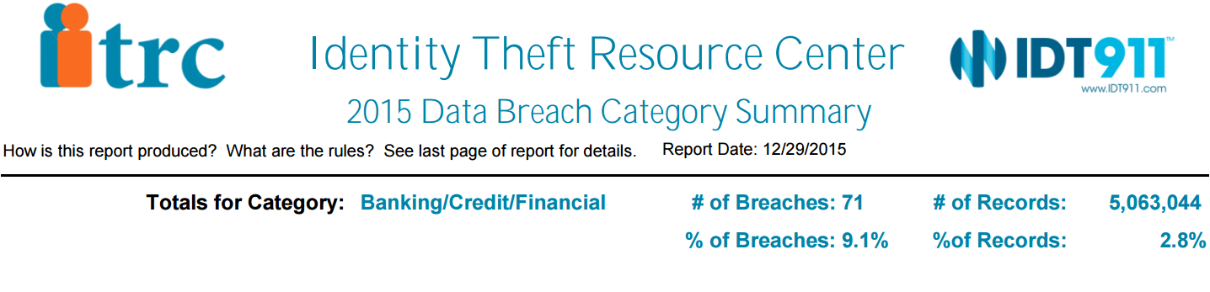
Banking breaches Summary 2014-2015

Slide 4
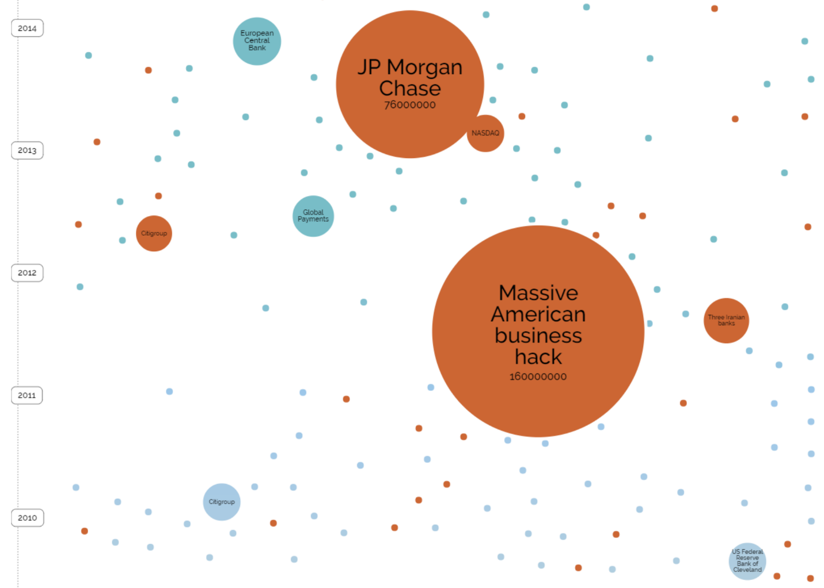
Notes:
Among the affected financial services organizations there is JP Morgan Chase, European Central Bank, US Federal Reserve Bank of Cleveland, Citigroup

Slide 5
eFontys Demo

Slide 6
Pen-Test Findings

Slide 7
Cloud Service
Features:
Register.
Login.
Upload files.

Slide 8
Path Traversal
Vulnerability found using Nikto software
CloudserviceSite/SePrWebsite/index.php/sips/sipssys/users/a/admin/user:
SIPS (Simple Internet Publishing System) v0.2.2 allows user account info (including password) to be retrieved remotely.

Slide 9
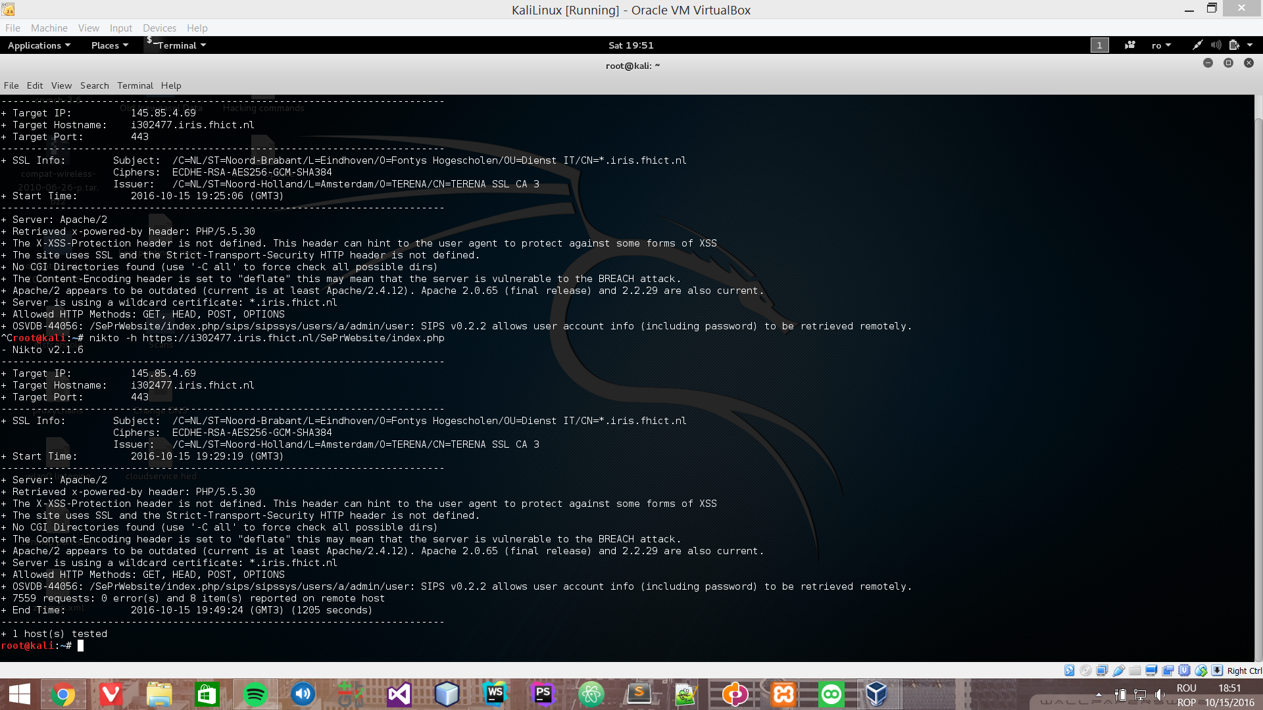

Slide 10
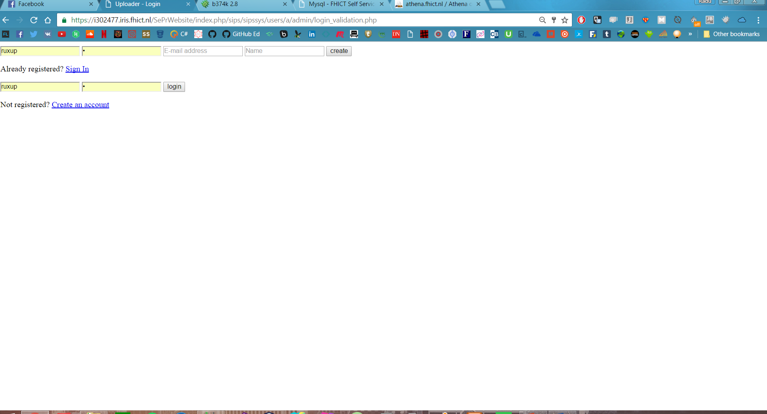

Slide 11
XSS Vulnerability
Web Browser XSS Protection is not enabled, or is disabled by the configuration of the 'X-XSS-Protection' HTTP response header on the web server

Slide 12
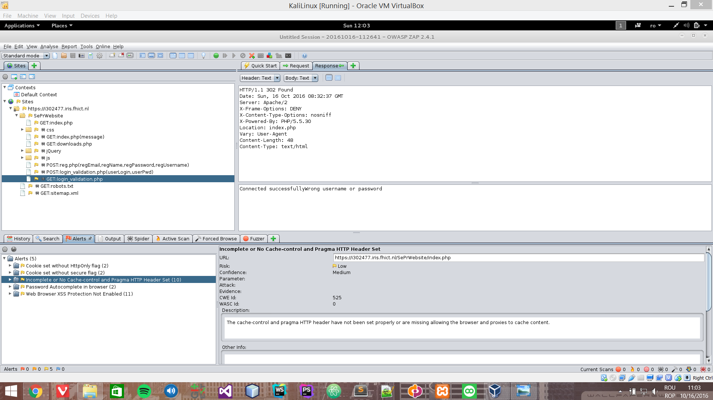

Slide 13
Brute Force attack
Password length, No password encryption.

Slide 14
Upload Vulnerability
We were able to upload a shell as a PHP file on the Cloud server and we got access to the whole server.

Slide 15
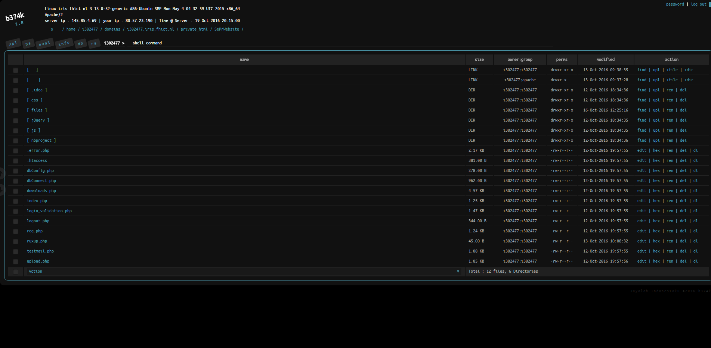

Slide 16
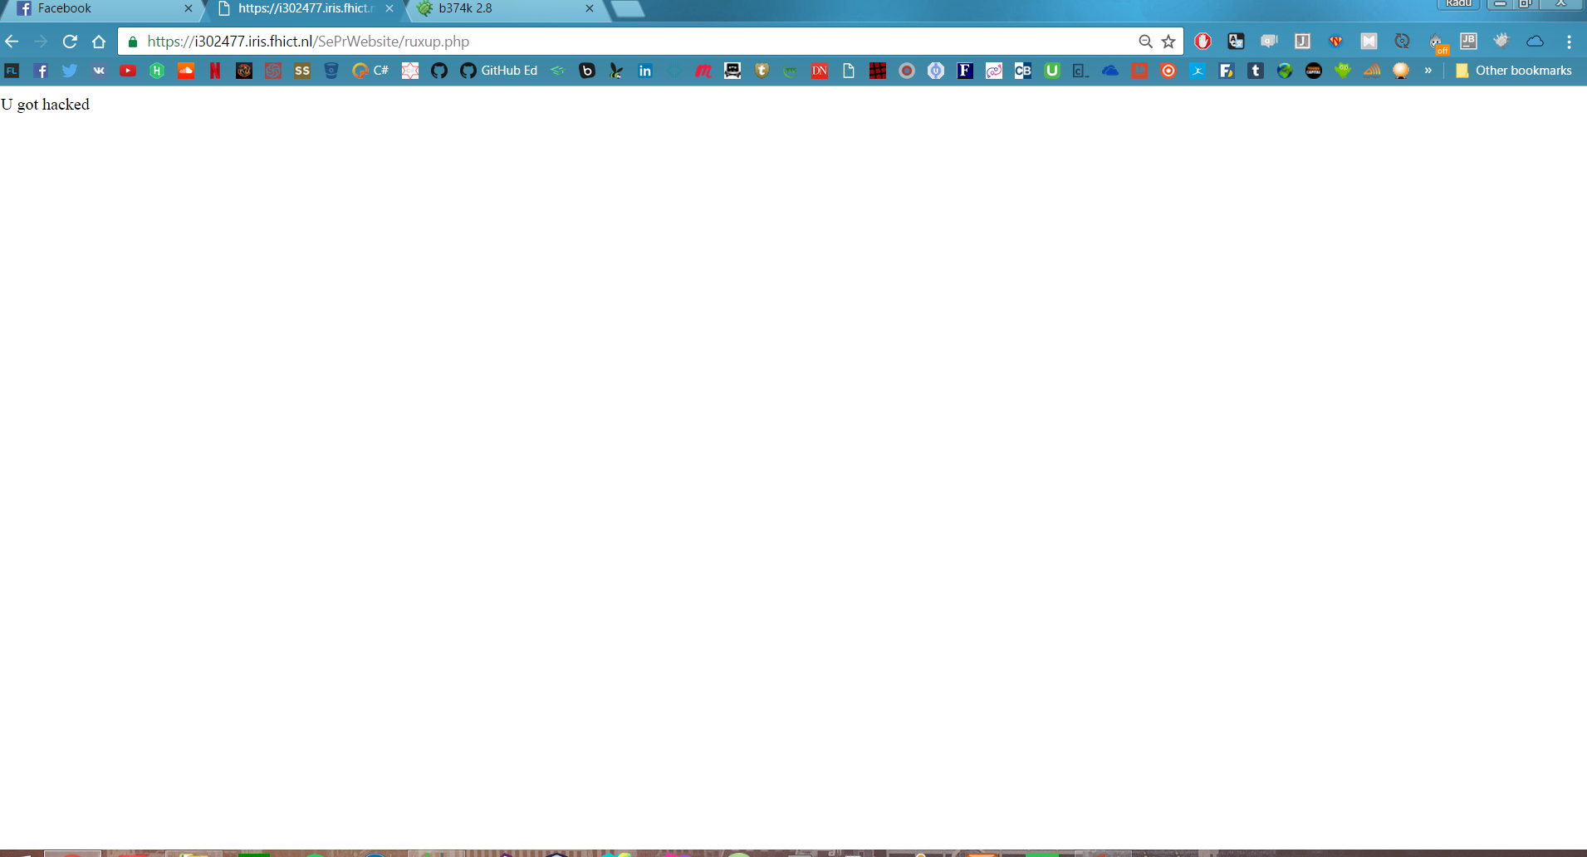

Slide 17
Conclusion

Slide 18
Secure Registration System
Add functionality
Prevent malicious files

